Slide 1
What is Swagger UI & How to use?
2018

Slide 2
What Is Swagger?
Swagger is an open-source software framework backed by a large ecosystem of tools that helps developers design, build, document, and consume RESTful Web services. While most users identify Swagger by the Swagger UI tool, the Swagger toolset includes support for automated documentation, code generation, and test-case generation.

Slide 3
What Is Swagger UI?
Swagger UI, a part of Swagger, is an open source tool that generates a web page that documents the APIs generated by the Swagger specification. This UI presentation of the APIs is user-friendly and easy to understand, with all the logical complexity kept behind the screen. This enables developers to execute and monitor the API requests they sent and the results they received, making it a great tool for developers, testers, and end consumers to understand the endpoints they are testing. Swagger UI represents APIs within the browser, so I find it more intuitive than other tools such as Postman, SoapUI, and others.

Slide 4
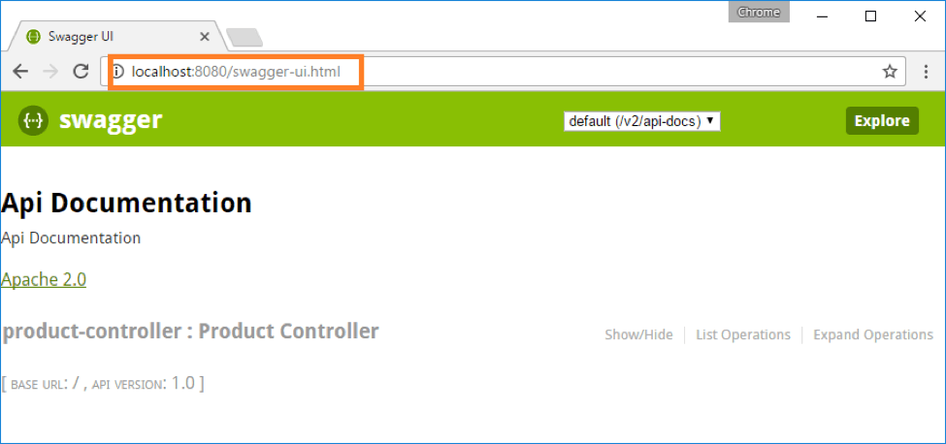
To add Swagger UI into our project, you need to add one more dependency (if not already added) to the pom.xml file. Then, go to the URL with SwaggerUI: http://<host>:<port>/swagger-ui.html

Slide 5
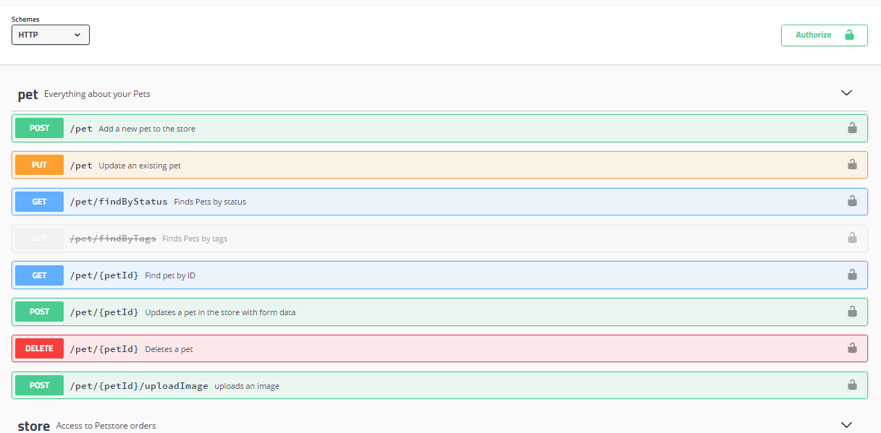
swagger ui dashboard

Slide 6
Technology4nextvision
Please Subscribe my channel for New Update!

